Slide 1

Different Religions,
Different Posts?
How do posts in the subreddits r/christianity, r/buddhism, r/islam, and r/atheism differ in language use?
By: Ami, Gian, Jenny, Mattéo and Mimi

Slide 2
Part I: Analytical vs. Emotional Language
Theoretical background:
Pennycook et al. (2017) find a negative correlation between religious belief and performance on analytical thinking measures in their meta analysis
H1: Posts in r/atheism use more analytical language, while religion subreddits are associated with more emotional language
Notes:
Religions are rooted in beliefs and are associated with a lot of emotions rather than analytical thinking

Slide 3
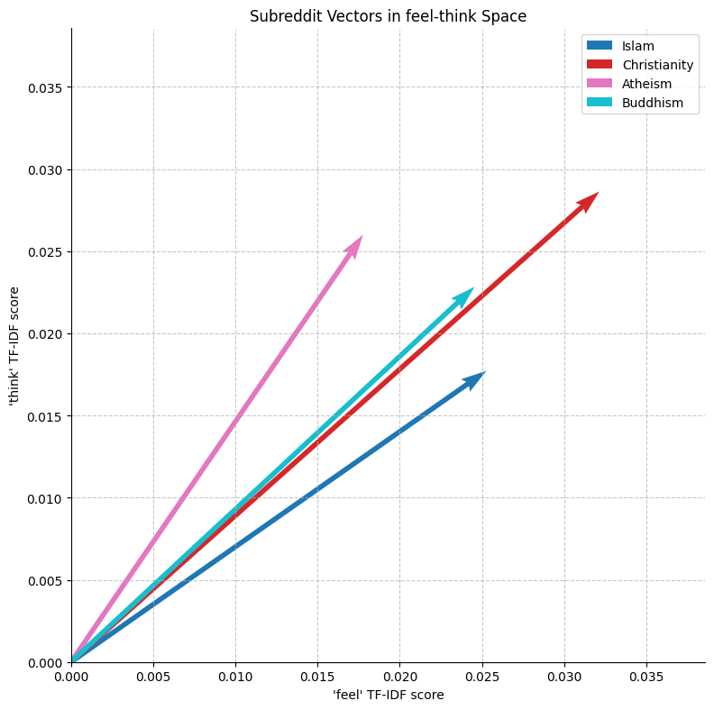
Posts in the r/atheism subreddit are closest to “think”, whereas posts in the r/islam subreddit are closest to “feel”
Angles between vectors
Christianity
1.2°
Islam
7.9°
6.7°
Atheism
12.7°
14°
20.6°
Buddhism
Christianity
Islam
Notes:
Cosine distance
For atheism we are more likely to see the word “think”, for islam more towards “feel”
Length indicates the words are slightly more noteworthy in the christianity reddit posts than in the other subreddits
Atheism and islam are the most distant ones

Slide 4
Applying a pre-defined lexicon for scoring “analytical” and “emotional” sentiments across subreddits (1/2)
Lexicon creation
Analytical words
Emotional words
explain, rational, although, despite, knowledge, evidence, proof, reason,...
sad, love, fear, regret, guilty, hate, emotional, angry, terrible, concern,...
Example sentences
Sentence with high analytical score
“1. Who wrote the Quran? (Provide evidence for the Quran) 2. Why do you think islam is the truth?”
Sentence with high emotional score
“I could be in the worst of the worst situations and I read maghrib then POOF its all gone, people who genuinely follow the religion are the best people.”
Notes:
Created a predefined dictionary with analytical words and emotional words to apply a scale to text of posts
Analytical: connectors (although), words associated with scientific knowledge (evidence, proof,...)
Emotional: feelings (fear, regret)
Chose 32 words for analytical and 37 words for emotional
Example sentences
Compared the text not the title
Scored the posts by counting the number of analytical/emotional words
Normalized by length of post
Multiplied by 100

Slide 5
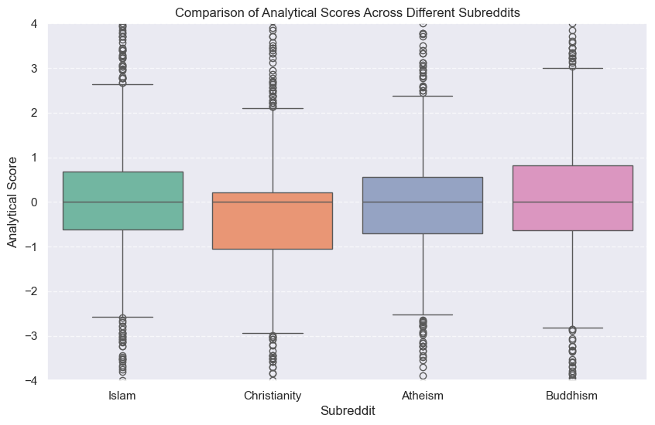
Applying a pre-defined lexicon for scoring “analytical” and “emotional” sentiments across subreddits (2/2)
Notes:
Median at around 0
Quartiles range for the different subreddits
Buddhism leans towards being more analytical
Christianity more emotional
Contradicts our results from the cosine distance (visual) analysis

Slide 6
Part II:
Word Associations
Theoretical background:
Schmidt et al. (2020) find that different subreddits talk differently about key religious concepts
H2: Collocations surrounding the words “love”, “death” and “god” within subreddits vary across subreddits

Slide 7
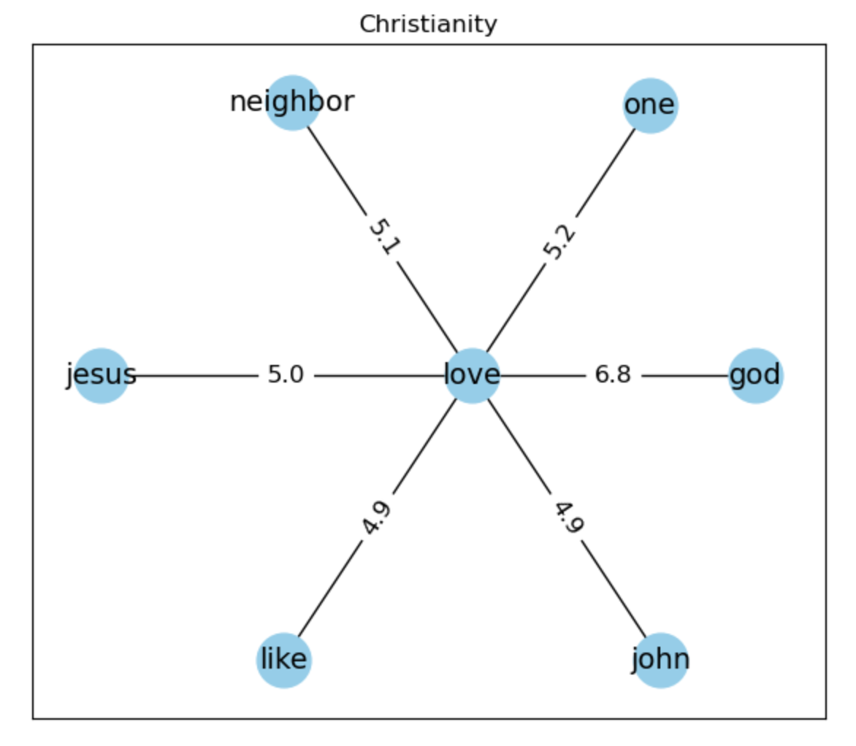
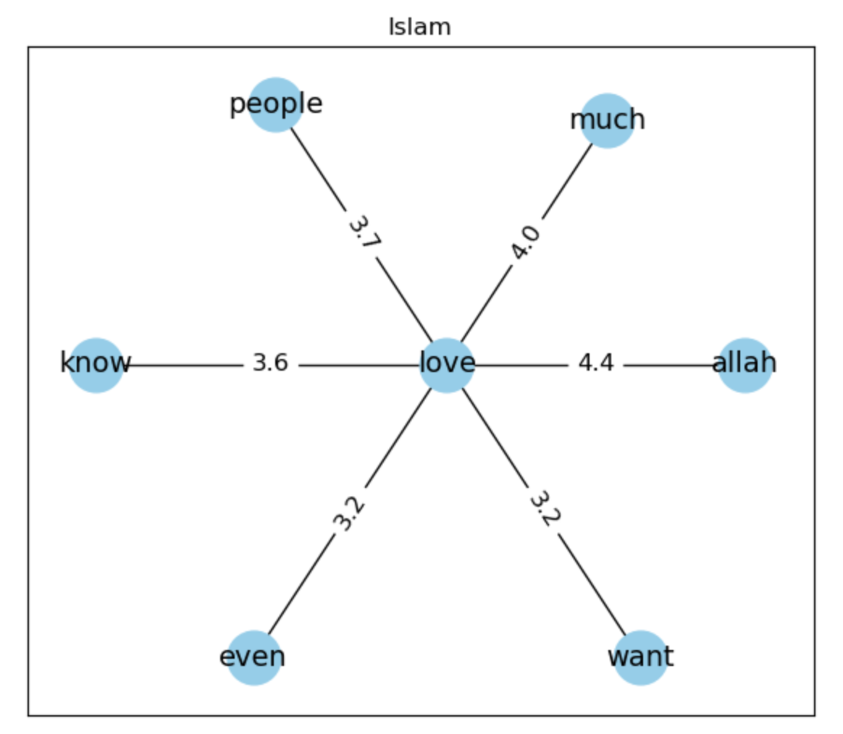
“Love” - Word Association using Pointwise Mutual Information (PMI)
Very strong PMI between “love” & “god”
“Love” in association with “neighbor”
Biblical references (“john”)
Strong PMI between “love” & “Allah”
“Love” in association with “people”
Notes:
PMI: Pointwise mutual information
Select window (10, 5 words left, 5 words right)
Probability that words occur together/divided by probability you expect if words are independent
Higher score indicates higher frequency of words occurring together
Differences and similarity (love your neighbors)
Colocated, close
Similarity: love & god/Allah
Difference. Love with neighbor vs love with people

Slide 8
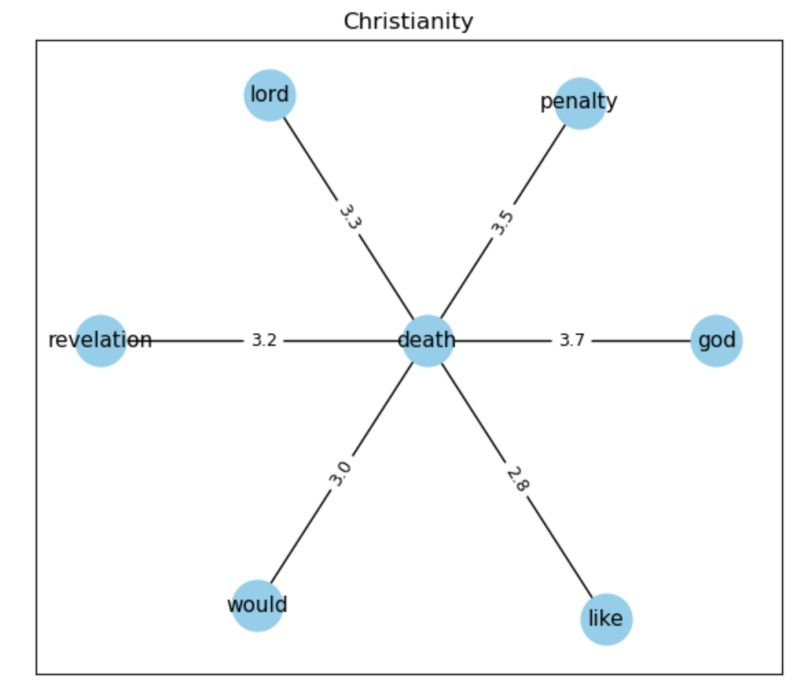
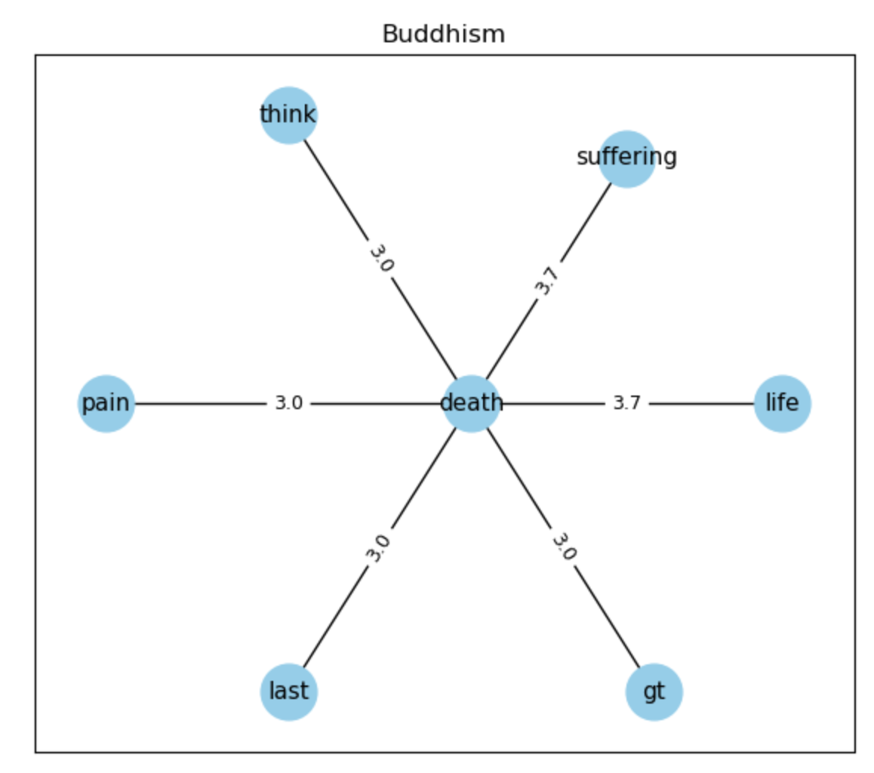
“Death” - Word Association using PMI
Strong PMI with “penalty”
Strong PMI with “god” and “lord”
Strong PMI with “suffering”, “pain”, and “life”
Association with “life” could reflect reincarnation
Notes:
Similarities: death with penalty; death with suffering, pain but also LIFE -> reincarnation
Differences: god and lord vs. gestalt therapy

Slide 9
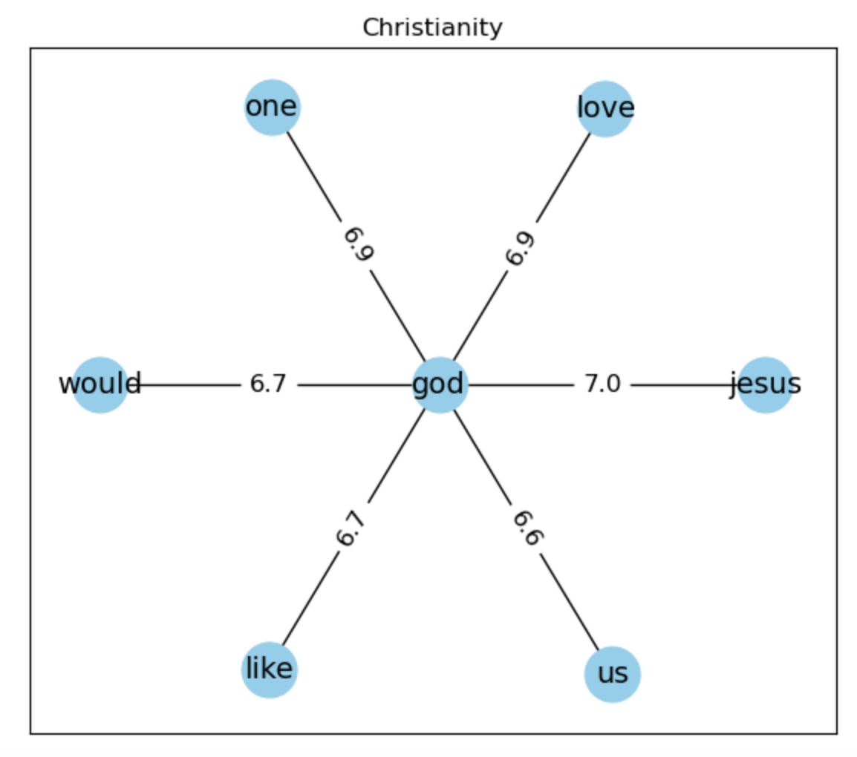
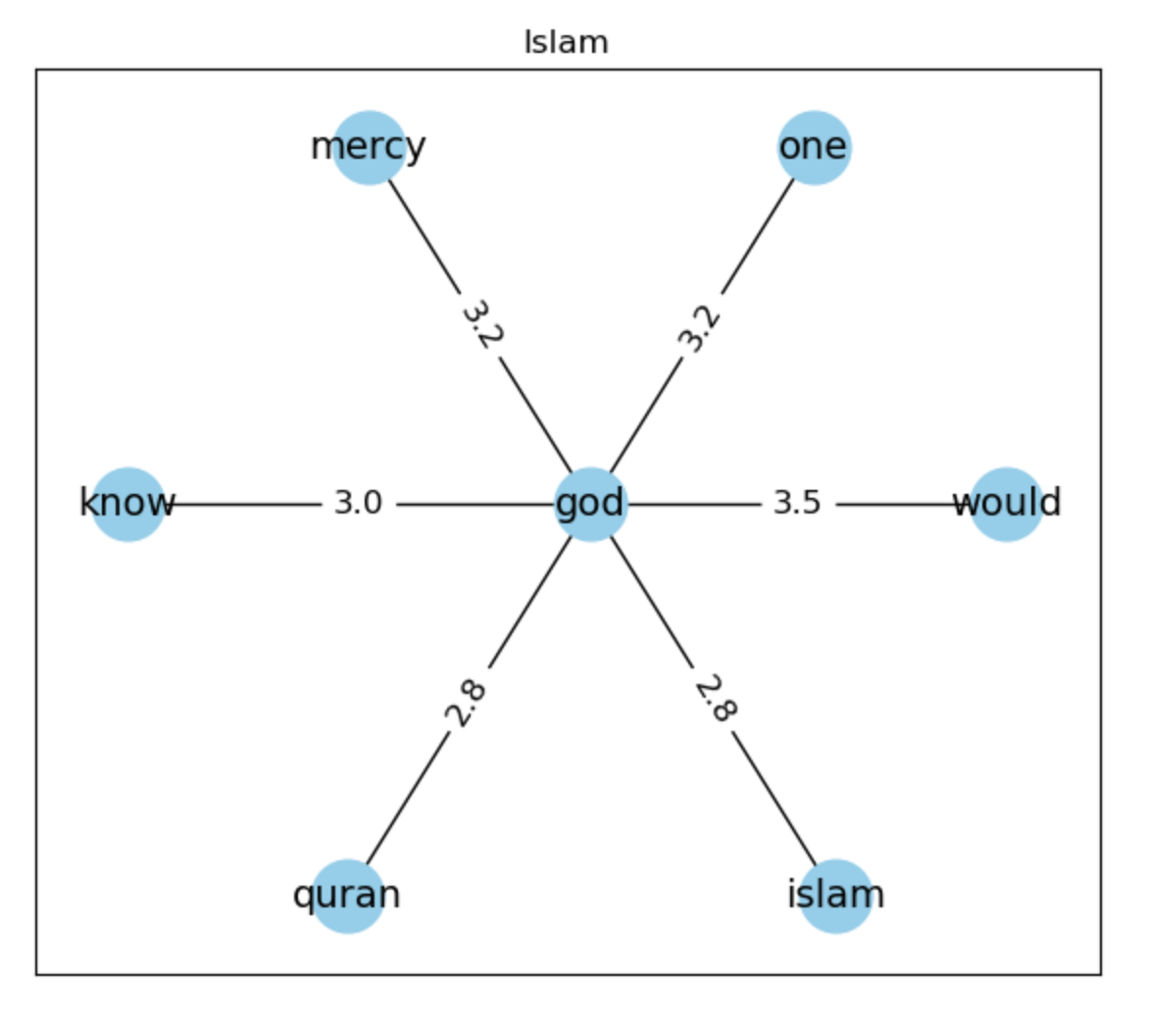
“God” - Word Association using PMI
“One” god corresponds to Christian narratives
Strong PMI with “Jesus” and commonly associated with “love”
“One” god corresponds to Islam narratives
Association with religious text “Quran”
Notes:
Similarities: One god
Differences: Jesus & love vs. Quran

Slide 10
Part III - Machine Learning Classification of Posts
Theoretical background:
Patel & Meehan (2021) found that Multinomial Naive Bayes achieved best accuracy rate as compared with other models for fake news detection on Reddit posts
H3: Language use across subreddits is distinct enough to allow accurate classification using supervised Machine Learning

Slide 11
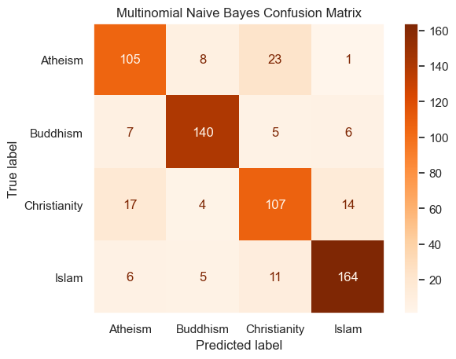
Classification of subreddits with Multinomial Naive Bayes
MNB Classification Report
Subreddit
Precision
Recall
F1-score
Atheism
0.78
0.75
0.76
Buddhism
0.84
0.89
0.86
Christianity
0.70
0.71
0.71
Islam
0.82
0.80
0.80
Overall model accuracy: 0.78
Notes:
Classified subreddits with Multinomial Naive Bayes using a 80 (train) /20 (test) split
Diagonal -> correctly classified posts
Off-diagonal -> misclassification (y-axis being the correct classification)
Highest misclassification for christianity & atheism
NB performed better than Logistic regression and Support Vector Matrix
BUT they all had higher misclassifications for Christianity and Atheism
F1-Score highest for buddhism, indicating model’s best performance in that class; christianity lowest
Overall model accuracy: 0.78 (78% of all predictions were correct)
Consequence for subreddits: buddhism most different as recognized by supervised ML, christianity vs atheism poorly across all models

Slide 12
Top ten words for each class sorted by log probability
Results
Atheism
Buddhism
Christianity
Islam
1
god
buddhism
god
allah
2
religious
buddha
jesus
islam
3
religion
buddhist
christian
quran
4
trump
like
just
muslim
5
people
life
like
know
6
just
practice
don
like
7
christian
know
bible
dua
8
atheist
meditation
know
haram
9
church
just
people
just
10
like
mind
love
help
Notes:
Log probability: logarithm probability that the word appears in a post, given that post belongs to that subreddit
-> words that are most strongly associated with that subreddit / most predictive
-> Atheism and christianity most similar -> worst classification
God being in atheism and christianity shows why the model performs poorly here

Slide 13
Limited text processing and quantification constitute areas of improvement
Research design
Lack of quantification of differences between subreddits possible for word associations
Sample selection
Limited external validity of Reddit data usage
Data
Omission of posts that are not in English and problems with spelling mistakes
Limited text processing (e.g., lemmatisation, stemming)
Operationalisation
Creation of lexicon with limited words
Operationalisation of rational vs. emotional through “feel” and “think”
We infer a connection between words through PMI without considering context
Notes:
Quant word associations

Slide 14
We have gathered partial support for our hypotheses, however, there is potential for future research
H1: Posts in r/atheism use more analytical language, while religion subreddits are associated with more emotional language
Limited support
H2: Collocations surrounding the words “love”, “death” and “god” within subreddits vary across subreddits
Supported
H3: Language use across subreddits is distinct enough to allow accurate classification using supervised Machine Learning
Supported
Potential for further research
Seasonality analysis using posts throughout whole year (re holidays)
Incorporating comments for analysis

Slide 15
Bibliography
Patel, A. and Meehan, K. (2021). Fake News Detection on Reddit Utilising CountVectorizer and Term Frequency-Inverse Document Frequency with Logistic Regression, MultinominalNB and Support Vector Machine. 32nd Irish Signals and Systems Conference (ISSC), Athlone, Ireland, 2021, pp. 1-6, doi: 10.1109/ISSC52156.2021.9467842
Pennycook, G. & Ross, R.M. & Koehler, D.J. & Fugelsang, J. A. (2017). Correction: Atheists and Agnostics Are More Reflective than Religious Believers: Four Empirical Studies and a Meta-Analysis. PLOS ONE 12(4): e0176586.https://doi.org/10.1371/journal.pone.0176586
Schmidt, T., Kaindl, F., & Wolff, C. (2020). Distant reading of religious online communities: A case study for three religious forums on reddit.

